Slide 1
Energy Efficiency

Slide 2

In this Smart Lesson you will learn to:
Explain that energy transfers and transformations in mechanical systems always result in some heat loss to the environment, so that the amount of useable energy is reduced.
Define efficiency.
Solve problems involving finding the efficiency of heat transfers.

Slide 3
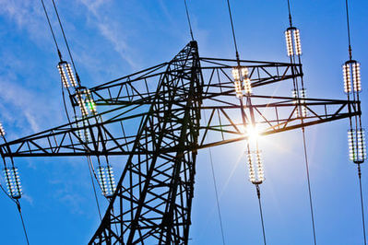
We classify energy as being either high grade or low grade.
High grade energy resources transform energy efficiently. Some examples are electrical energy, solar energy, and chemical energy.
Low grade energy resources transform energy inefficiently. The main low grade energy resource is heat.
Open systems always transform high grade energy resources into low grade energy resources.

Slide 4

Energy efficiency is defined as the ratio of useful work performed by a machine or in a process, to total energy expended or heat taken in.
Energy efficiency (η) shows how much input energy produces useful output energy.
E_{in​} represents energy input, total energy used, or total work input.
E_{out}​ represents energy output, useful energy transferred, or useful work output.
This may seem confusing, but it is essentially useful energy or work you get out of the system divided by the total energy or work you put into the system.

Slide 5

Energy efficiency can never be greater than 100%.
This is because the law of conservation of energy means that we can't get more energy out of a system than we put in.
Most systems are a lot less efficient than we might expect. For example, cars have an efficiency of η≈30%. Only around 30% of the chemical energy produced from fuel combustion is used to power the car. This might seem very low, and this is because cars produce a lot of heat and sound energy which makes them less efficient.

